Slide 2
Galatians 5:1-15

Slide 3
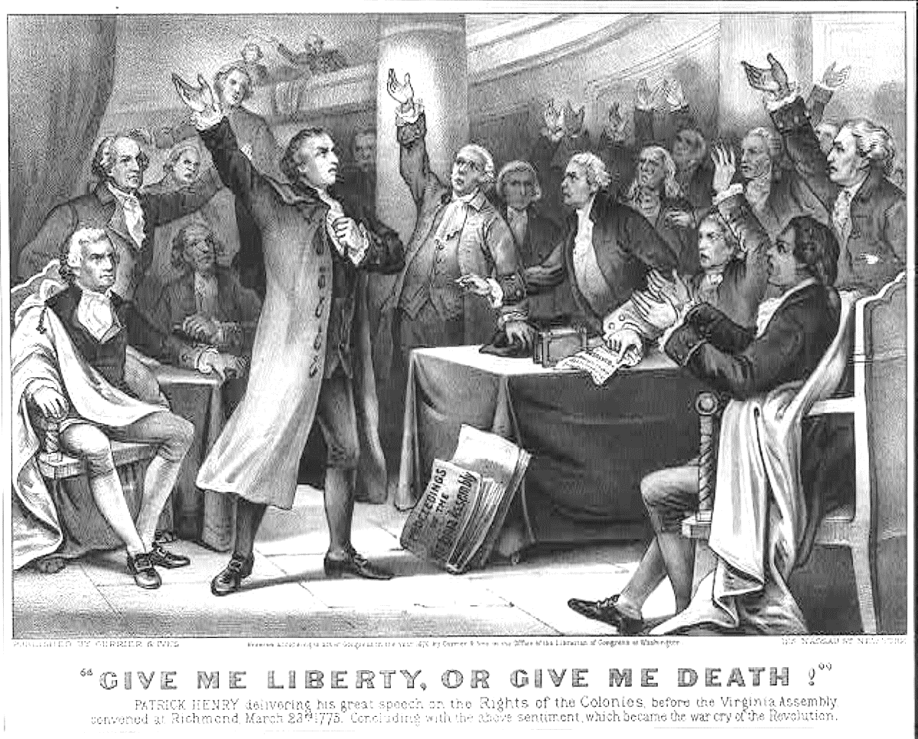
Patrick Henry
“It is vain, sir, to extenuate the matter. Gentlemen may cry, Peace, Peace but there is no peace. The war is actually begun! The next gale that sweeps from the north will bring to our ears the clash of resounding arms! Our brethren are already in the field!
Why stand we here idle? What is it that gentlemen wish? What would they have? Is life so dear, or peace so sweet, as to be purchased at the price of chains and slavery? Forbid it, Almighty God! I know not what course others may take; but as for me, give me liberty or give me death!”

Slide 4
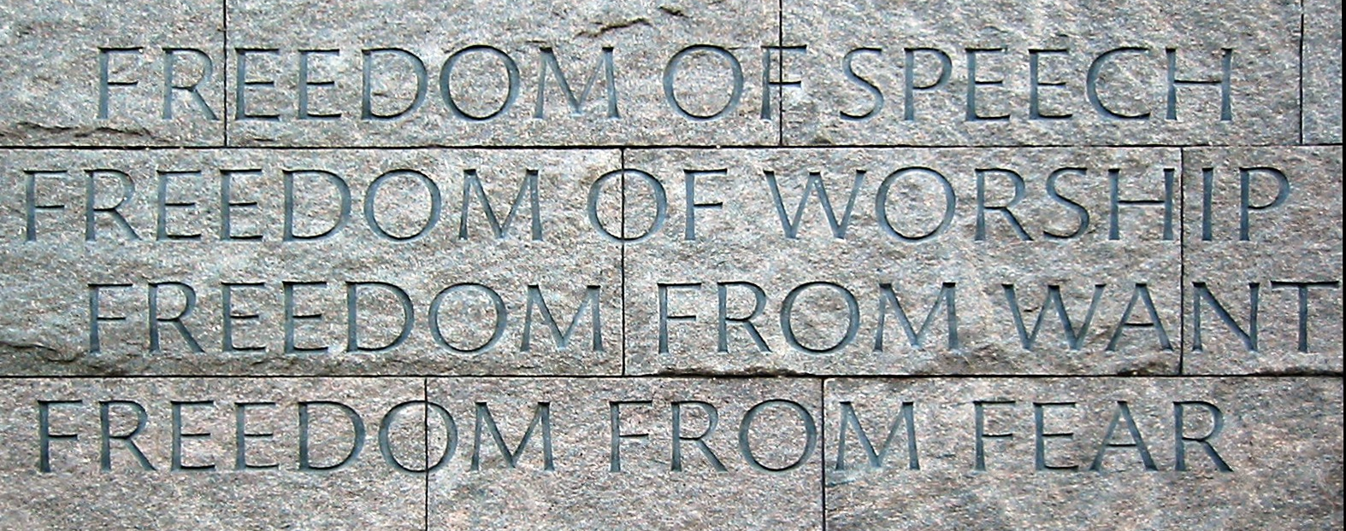

FREEDOM FOR EVERYONE!
SECURED BY THE SHEDDING OF BLOOD

Slide 5
The Liberty We Long For-
Freedom From The Guilt Of Sin!
"Stand fast therefore in the liberty by which Christ has made us free,....."

Slide 6
Freedom That Is In Christ!
The ONLY FREEDOM that really matters!
The Whole World Under SIN! John 8:31-36
Galatians 4:8 “served those which by nature are not gods.”
Romans 3:9 “both Jews and Greeks that they are all under sin.”
2 Corinthians 5:17 “if anyone is in Christ, he is a new creation…”

Slide 7
“Do not be entangled again with a yoke of bondage”
Galatians 5:2 “if you become circumcised”
Galatians 5:3 “every man who becomes circumcised”
Galatians 5:6 “neither circumcision nor uncircumcision”
Galatians 5:11 “if I still preach circumcision”
Galatians 5:12 “that those who trouble you would even cut themselves off!”
Galatians 5:4 “become estranged from Christ" and had "fallen from grace!"
Human Philosophy/ Traditions Threaten Liberty – Colossians 2:8

Slide 8
THE DANGER IS STILL HERE!
Various forms of ANGLO-ISRAELISM and PREMILLENNIALISM
The Bible teaches NO SUCH DOCTRINE!
HUMAN PHILOSOPHIES such as EVOLUTION and SECULAR HUMANISM
Many leaning toward EASTERN or MYSTICAL FORMS of religion!
Galatians 5:13 “do not {use} liberty as an opportunity for the flesh”
LIBERTY IS NOT LICENSE! Galatians 5:14

Slide 9
Biggest Threat To Liberty Is Worldliness!
Galatians 5:16,17 “not fulfill the lust of the flesh”
Galatians 5:19-21 “works of the flesh”
The Practice of these will KEEP YOU OUT of the HEAVENLY KINGDOM!
God is ONLY pleased when we are DOING HIS WILL – Matthew 7:21 “ he who does the will of My Father in heaven."
Galatians 5:22-25 “the fruit of the Spirit”
“WALK IN THE SPIRIT” “FRUIT OF THE SPIRIT” FAITHFUL SERVICE to GOD - ushered into that ETERNAL HOME

Slide 10
Do You Enjoy That FREEDOM?
If NOT, WHY NOT?
Is It Because You NEVER HAD IT?

Slide 11
Why Not Take HOLD OF IT NOW?
Is It Because You LOST IT?
Come BACK to HIM and RECLAIM IT!

